Slide 1
Lab #5
Remote Sensing

Slide 2
Intro
Intro
KestrelSAT
Reference
Task 1
Task 2
Task 3
Task 4
Task 5
Task 6
Turn-in Reqt’s
In this lab you will test KestrelSAT’s Arducam payload to determine if KestrelSAT's imaging system meets its theoretical capabilities.
You will record images of a resolution chart to determine the best resolution KestrelSAT can achieve at distances ranging from 0.5 m to 5 m.
In the postlab, you’ll compare this resolution to the theoretical pixel-limited and diffraction-limited resolution of the sensor and lens.
Authorized Resources – LAB
Lab activities are team effort
Any non-human resource
Generative AI Level 3 Allowed
Astro 331 course notes/instructor
Authorized Resources - POSTLAB
Postlab turn-in is individual effort
Generative AI Level 0 Allowed (GenAI not allowed)
Astro 331 course notes/ instructor
Objectives:
Understand fundamentals of remote sensing via practical experimentation.
Interpret imaging sensor system parameters.
Calculate Pixel and Diffraction Resolution using real data.
Compare experimental camera resolution to theoretical resolution.
Examine limitations of imaging sensors.

Slide 3
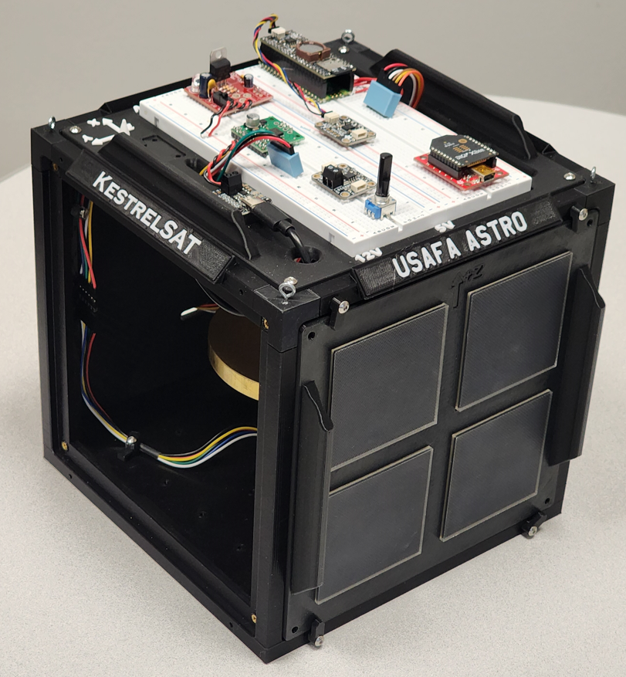
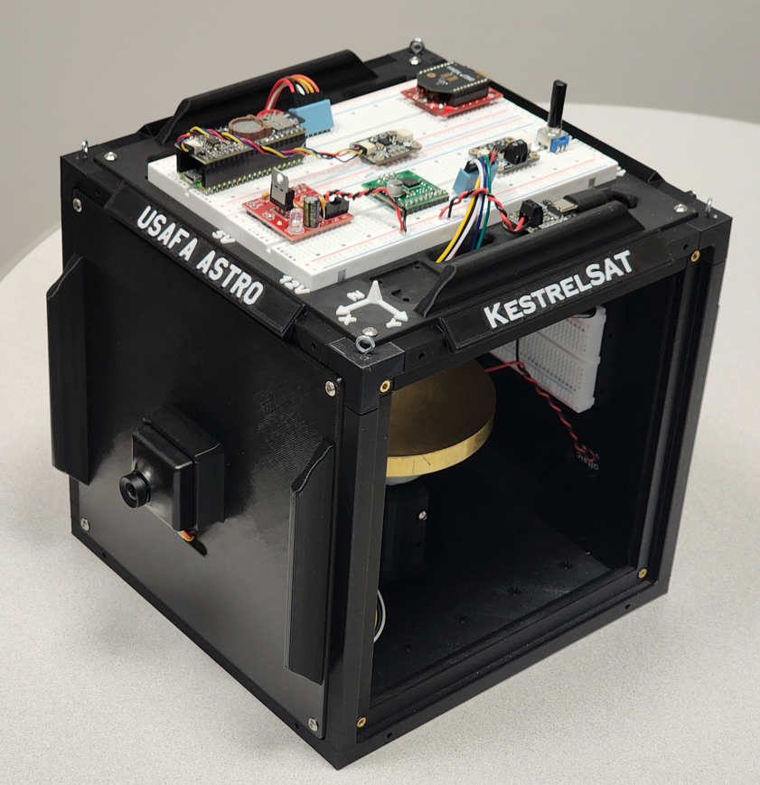
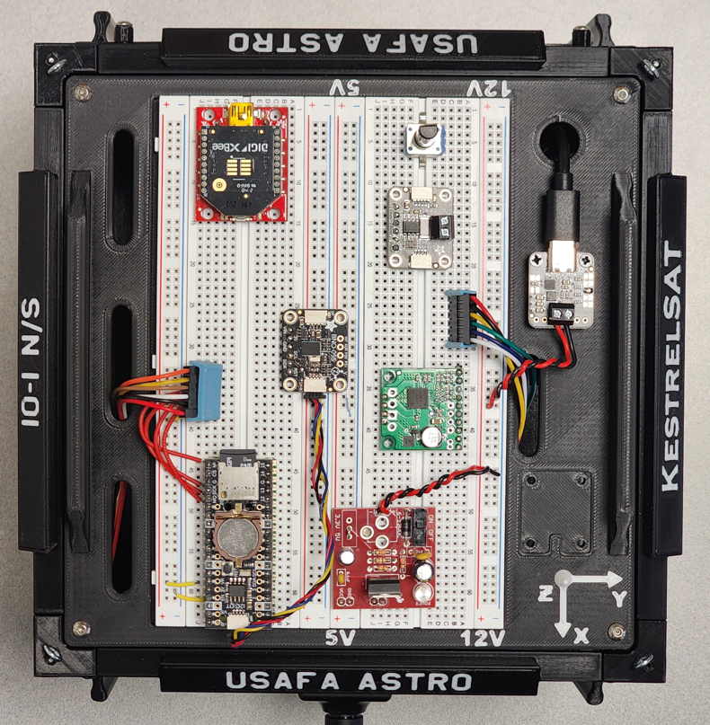
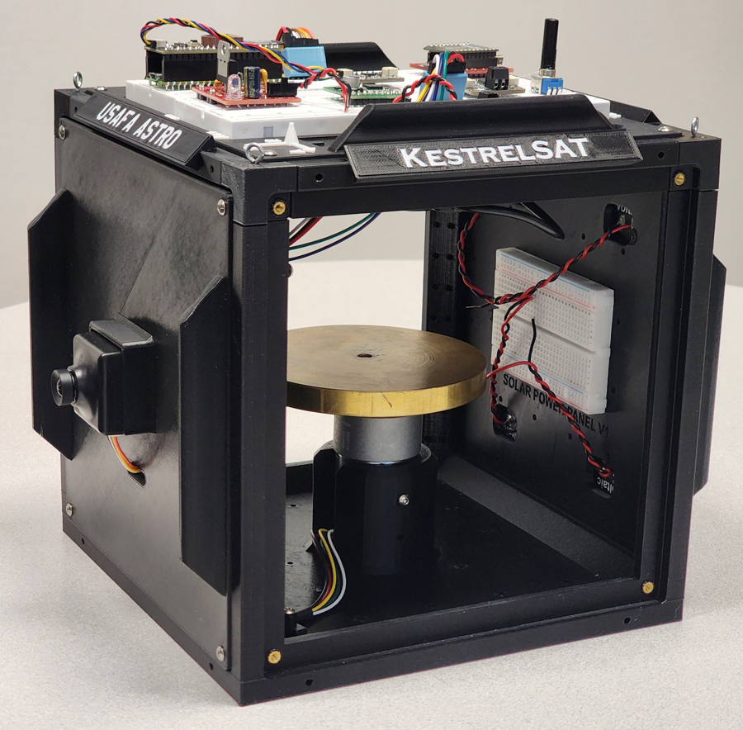
KestrelSAT Overview
Intro
KestrelSAT
Reference
Task 1
Task 2
Task 3
Task 4
Task 5
Task 6
Turn-in Reqt’s
Solar Power Side
Reaction Wheel
Camera Side
Solar Power
V & I Sensor
Comm (Xbee transceiver)
Battery Controller
IMU (BNO055)
Motor Driver
MCU (Rpi Pico)
Memory (SD)
Real-Time Clock
12V DC to 5V DC Regulator

Slide 4
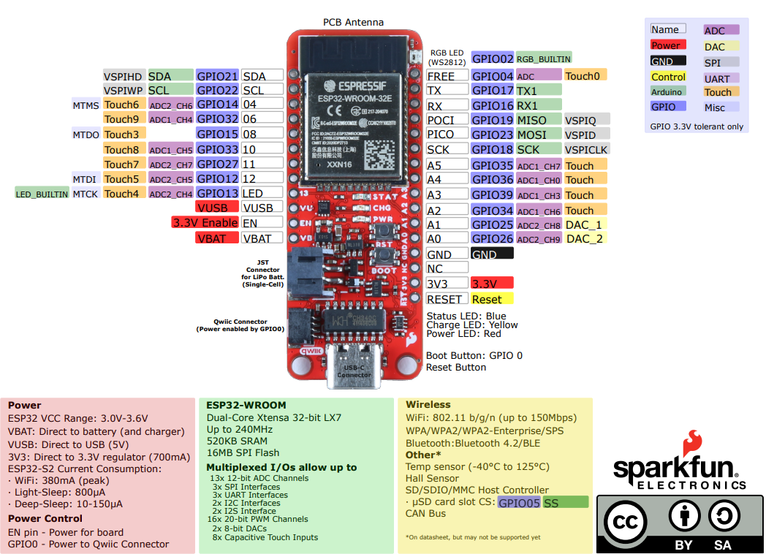
ESP32 Thing Plus Pinout Diagram
Intro
KestrelSAT
Reference
Task 1
Task 2
Task 3
Task 4
Task 5
Task 6
Turn-in Reqt’s

Slide 5
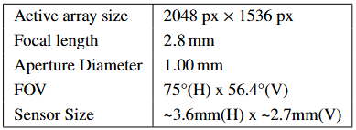
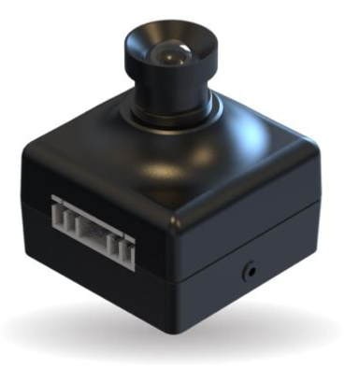
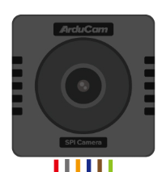


Reference – ArduCam Mega 3MP SPI Camera
KestrelSAT’s Payload is a 3MP SPI camera made by ArduCam (SKU: B0434).
You will connect the camera to KestrelSAT’s MCU via SPI (see next slide) and control it over a USB connection.
Intro
KestrelSAT
Reference
Task 1
Task 2
Task 3
Task 4
Task 5
Task 6
Turn-in Reqt’s
Documentation
Product Page
Arducam Mega SPI Camera
Quick Start for Mega Camera
Mega SPI Camera Application Note
Troubleshooting
ArduCam Raspberry Pi Pico Documentation
Image Sensor
Product Series | Arducam Mega
Optical Size | 1/4''
Speed | 8Mhz
Number of effective pixels | 2048x1536
Power Supply | 3.3V/5V
Interface | SPI(4-wire)
Shutter Type | Rolling Shutter
Color Filter Type | Color
Output Format | RGB/YUV/JPEG
Lens
Lens Mount | M12 Mount
Field of View | 90°(D)x75°(H)x56.4°(V)
F.NO | F2.8
EFL | 2.8mm
BFL | 2.6mm
IR Sensitivity | Integral IR-cut filter, visible light only
Focus Distance | 0.6m-INF
Electrical and Mechanical
Power Consumption(idle/Working) | max 0.3w/1.58w
Electric Current (Idle/Working) | max 69mA/317mA
Connector No. | XH2.54-6P
Overall Size | 33×33×35mm

Slide 6
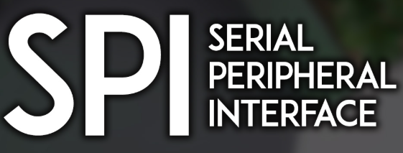
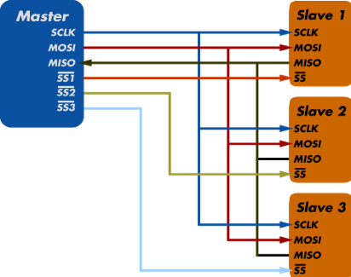
Reference – Serial Peripheral Interface (SPI)
SPI is a synchronous serial communication protocol used to transfer data between a microcontroller (the master) and one or more peripheral devices (the slaves) at high speed.
Features:
Full-duplex: Data can be sent and received simultaneously.
High-speed: Faster than protocols like I²C or UART (can reach tens of MHz).
Simple hardware: Requires just a few dedicated lines.
SPI Signals:
SCLK (Serial Clock) – Generated by the master, synchronizes data transfers.
MOSI (Master Out, Slave In) – Data line from master to slave(s).
MISO (Master In, Slave Out) – Data line from slave back to master.
CS/SS (Chip Select / Slave Select) – Active-low line controlled by master to enable a specific slave.
For multiple slaves, each has its own CS line, while SCLK, MOSI, and MISO are shared.
Intro
KestrelSAT
Reference
Task 1
Task 2
Task 3
Task 4
Task 5
Task 6
Turn-in Reqt’s
Warning
Make sure to connect power and ground between devices as well!

Slide 7

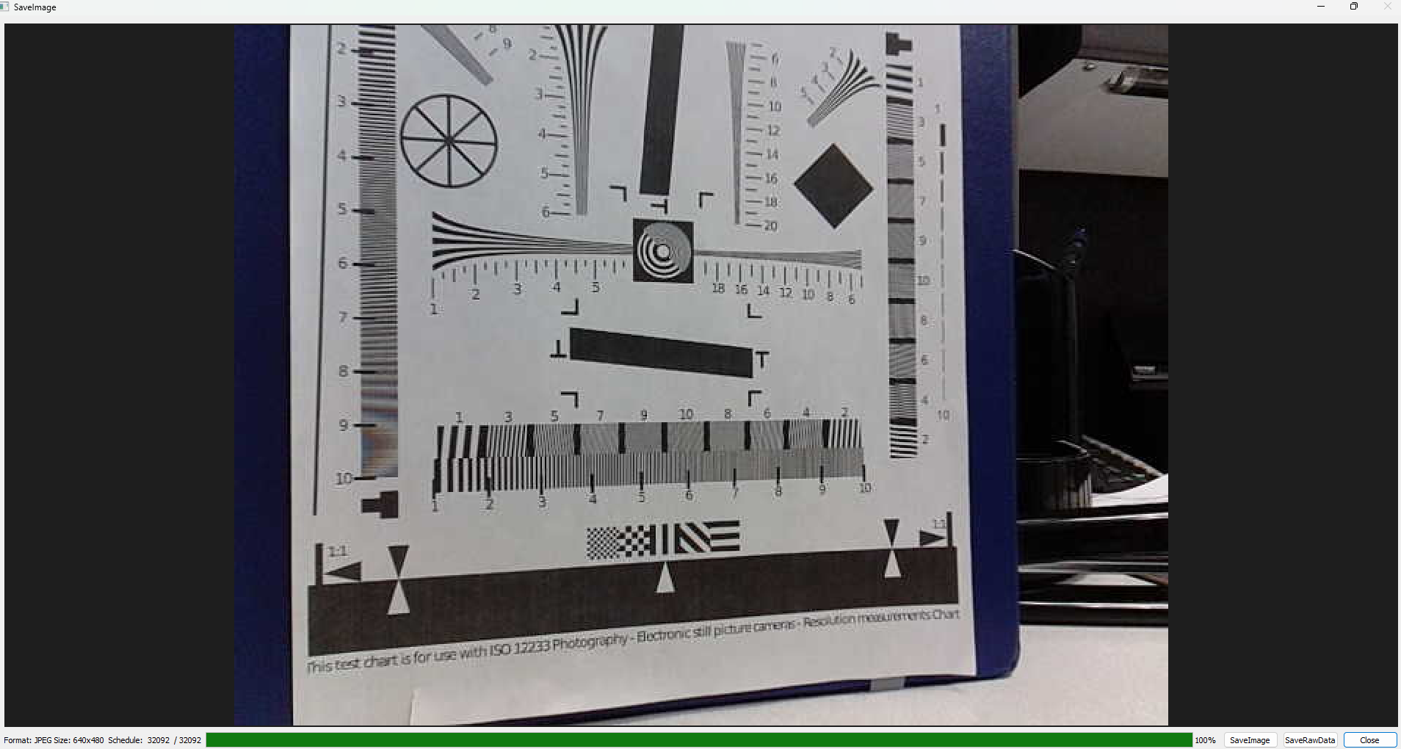
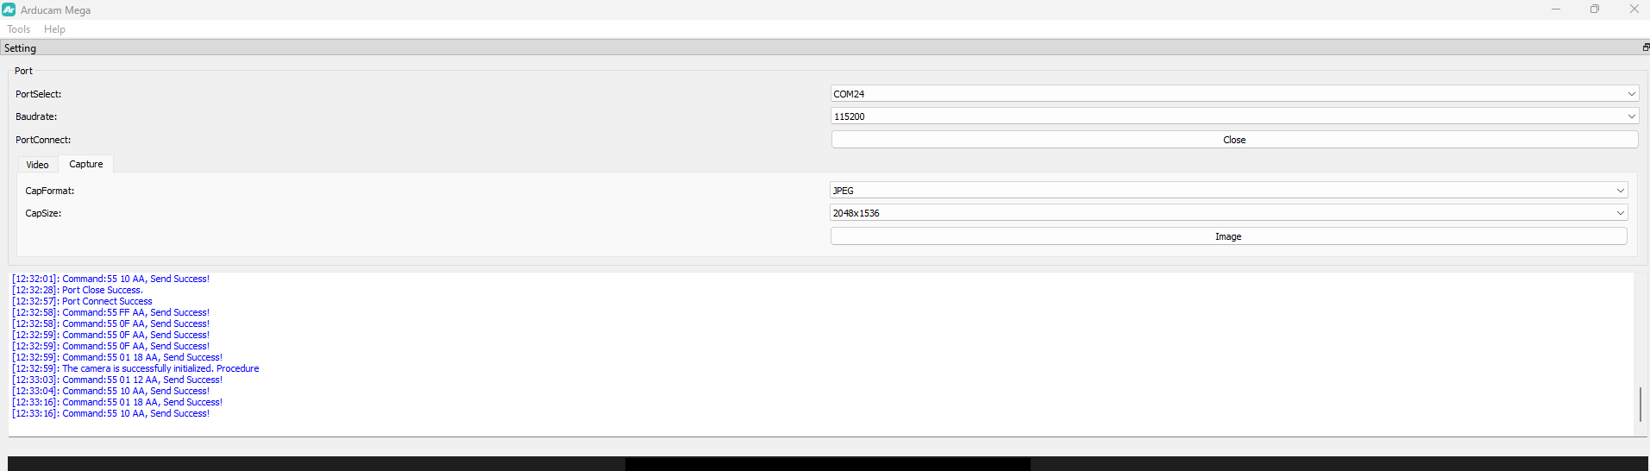
Reference – ArduCam Mega GUI Tool
Intro
KestrelSAT
Reference
Task 1
Task 2
Task 3
Task 4
Task 5
Task 6
Turn-in Reqt’s
The ArduCam Mega GUI Tool is a desktop application that we’ll use to communicate with KestrelSAT’s MCU, which will in turn command the camera and receive data from it.
The program sends binary data (in hexadecimal bytes) to the MCU for each command. The code file ArducamLink.cpp has a function to parse these bytes into commands for the camera.

Slide 8
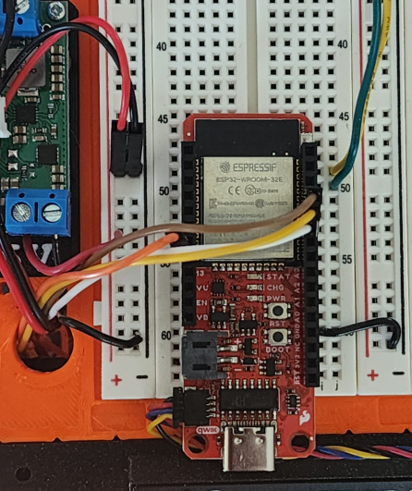
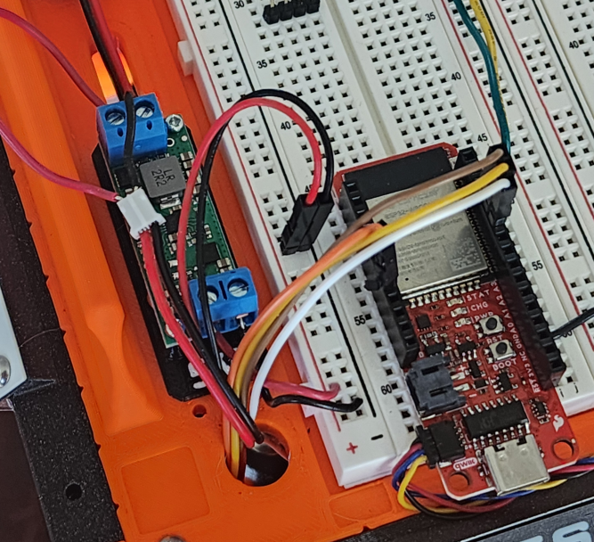
Task 1 – Hardware Setup
Intro
KestrelSAT
Reference
Task 1
Task 2
Task 3
Task 4
Task 5
Task 6
Turn-in Reqt’s
In this task, you’ll connect the Arducam to KestrelSAT’s MCU.
Connect the wires from the ArduCam to your MCU as follows:
Connect GND of the camera (black wire) to GND rail
Connect Vin of the camera (red wire) to 5V rail
Connect SCK of the camera (white wire) to GP18
Connect MISO of the camera (brown wire) to GP23
Connect MOSI of the camera (yellow wire) to GP19
Connect CS of the camera (orange wire) to GP12
Additionally, re-configure the power path so the 5V regulator is powered directly from KestrelSAT’s battery. This is necessary to ensure the camera is not powered by 5V from USB, which sometimes cannot source as much current as the camera needs.
Remove the JST connector from the MCU’s battery port.
Connect Vin and GND wires of the regulator’s input directly to the JST connector. Now the battery (via the power switch) only powers the camera and 5V rail of KestrelSAT. The MCU must be powered via USB.
5V regulator

Slide 9
Task 2 – Software Setup
In this task, you’ll install the ArduCam Mega GUI Tool and upload Arduino code to your MCU.
Intro
KestrelSAT
Reference
Task 1
Task 2
Task 3
Task 4
Task 5
Task 6
Turn-in Reqt’s
Download ArducamMegaSetup_Windows_x64.exe from the Lab 5 folder on Teams and install the application.
Download Astro331_Lab5_Code folder from teams or instructor USB and open it in PlatformIO as you have done in previous labs. Upload the code to your MCU.
**You may have to turn off the power to the camera (using KestrelSAT’s power switch) for the code to upload properly (remember to turn it back on after upload)**
The Blue STAT LED located near the center of the MCU board should illuminate if the camera connected properly to the MCU.

Slide 10
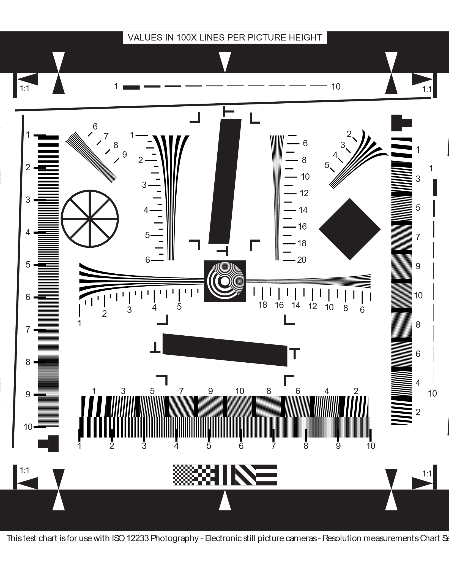
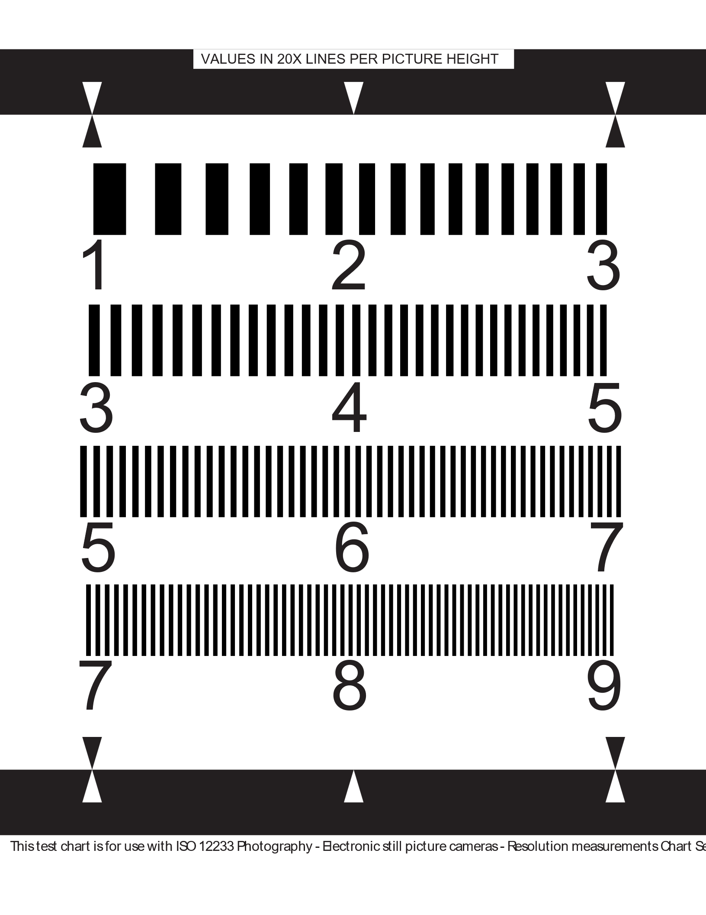
Task 3 – Prepare Resolution Chart
There are two resolution charts printed at your lab station. They are also available electronically with these lab instructions.
ISO_12233-reschart letter
ISO_12233-reschart big
(1) Using the metric ruler at your lab station, measure the height of the resolution chart (triangle-to-triangle). Note the remark at the top, e.g. "VALUES IN 100X LINES PER PICTURE HEIGHT."
(2) Verify the scale of the resolution markings. If the image height is 200 mm, at the 1 mark there should be 100 lines/200 mm, making each line is 2 mm wide.
(3) Note this scale for later use after the lab.
(4) Repeat these steps for the large resolution chart.
Intro
KestrelSAT
Reference
Task 1
Task 2
Task 3
Task 4
Task 5
Task 6
Turn-in Reqt’s
To determine the camera's resolution for each distance, find the point where you can barely distinguish each individual line. Refer to the scale you recorded. If the smallest lines you can resolve are 2/3 mm wide, your camera's resolution is 0.667 mm.

Slide 11
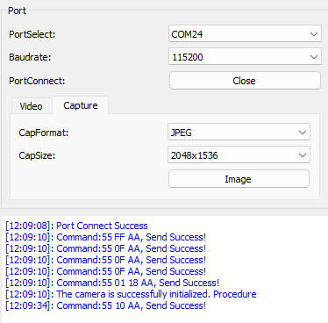
Task 4 – Connect to ArduCam
Intro
KestrelSAT
Reference
Task 1
Task 2
Task 3
Task 4
Task 5
Task 6
Turn-in Reqt’s
Connect KestrelSAT’s MCU to your computer via USB. Verify the blue LED in the center of the MCU is lit, indicating the camera booted up properly.
Open ArduCam Mega GUI Tool.
Select the COM port of your MCU
Select Baudrate of 115200 bps.
Select ‘Open.’
Select to the ‘Capture’ menu. Verify ‘CapFormat’ is ‘JPEG’ and ‘CapSize’ is 2048x1536.
Select ‘Image’ and verify that a camera image is displayed properly. Downloading the image will take several seconds.
You can download the image to your computer using the ‘SaveImage’ button.

Slide 12
Task 5 – Collect ArduCam Images
Intro
KestrelSAT
Reference
Task 1
Task 2
Task 3
Task 4
Task 5
Task 6
Turn-in Reqt’s
Use your camera to record images at distances of 0.5 m, 1 m, 2m, and 5m.
Position the camera and resolution chart so that they are perpendicular at the same height and 0.5 m apart. Ensure the chart is illuminated evenly and both objects are sufficiently supported to remain still during image capture.
Click “Image” to take the image. Wait a few seconds for the data to transfer back to the computer.
Focus the camera. Subjectively assess the focus of the image. Rotate the lens slightly to attempt to improve the focus. (use the mark on the lens to assess how far you’ve rotated the lens). Re-take a photo and assess the focus again. Repeat this process until you’ve improved the focus as much as possible.
Once you are satisfied with the focus, capture and download an image for your postlab analysis. Record the distance in the filename.
Repeat this process for the distances calculated in your prelab (1, 2, and 5 m).

Slide 13
Task 6 – Examine Resolution at Edges of Image
Intro
KestrelSAT
Reference
Task 1
Task 2
Task 3
Task 4
Task 5
Task 6
Turn-in Reqt’s
Capture a few images where the resolution scale is placed near the corner of the image. In your postlab analysis, you’ll examine if the resolution at the corners of the image is better or worse than in the center.

Slide 14
Turn-In Requirements
For this lab, you’ll complete a Postlab analysis of your resolution data, comparing it to theoretical resolution of the camera. For your calculations, use values from Reference – ArduCam Mega 3MP SPI Camera slide.
Calculate the expected diffraction resolution and pixel resolution for the camera using the information provided in the reference slides at distances of 0.5m, 1m, 2m, 5m, and 200km. Show all work and clearly state all assumptions. Is the camera diffraction-limited or pixel-limited?
Display data from (1) along with the actual resolutions you found for each distance during the lab (see Task 3 for how to determine resolution) in a table as shown below.
Postulate at least three reasons for the differences between the theoretical and actual resolution. Do you think the actual camera could detect a city block at 200km altitude of KestrelSAT?
Is your resolution different in the corners vs. the center of the image? If so, discuss possible causes.
----------------------------------------------------------------------------------
KestrelSAT (orbit altitude = 200km) must be able to detect Chinese aircraft carriers in the south pacific. Using your best judgment (simple google searches ok, do not use GenAI), determine a resolution requirement for this task and describe your rationale for it. Using the same ArduCam image sensor as is currently installed, determine parameters for a new lens (focal length and aperture diameter) to meet this requirement. What is the swath width for this camera setup? Show all work and clearly state all assumptions.
Intro
KestrelSAT
Reference
Prelab
Task 1
Task 2
Task 3
Task 4
Task 5
Task 6
Turn-in Reqt’s
Arducam Mega 3MP Camera Resolution
Distance | Theoretical Diffraction | Theoretical Pixel | Actual
0.5 m
1 m
2 m
5 m
200 km |  |  | N/A
Turn-In Format
Provide answers digitally.
Math work may be handwritten.
Include a documentation statement.
Authorized Resources - POSTLAB
Postlab turn-in is individual effort
Generative AI Level 0 Allowed (GenAI not allowed)
Astro 331 course notes/ instructor

